Slide 1
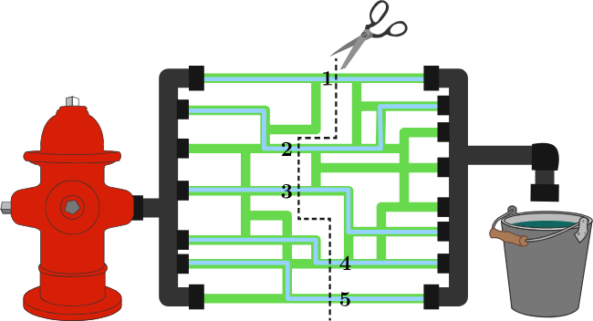
Max-flow Min-cut Algorithm
Finding maxflow from min-cut by Incrementally improving
Picture source: https://brilliant.org/wiki/max-flow-min-cut-algorithm/

Slide 2
Max Flow: Definitions
Flow network: directed graph (a.k.a. di-graph) where each edge has a capacity, and each edge receives a flow. The amount of flow on an edge cannot exceed the capacity of the edge
Max Flow Problem: finding a feasible flow through a flow network that obtains the maximum possible flow rate from the source to the sink
History:
First formulated in 1954 by T. E. Harris and F. S. Ross as a simplified model of Soviet railway traffic flow.
In 1955, Lester R. Ford, Jr. and Delbert R. Fulkerson created the first known algorithm, the Ford–Fulkerson algorithm.

Slide 3
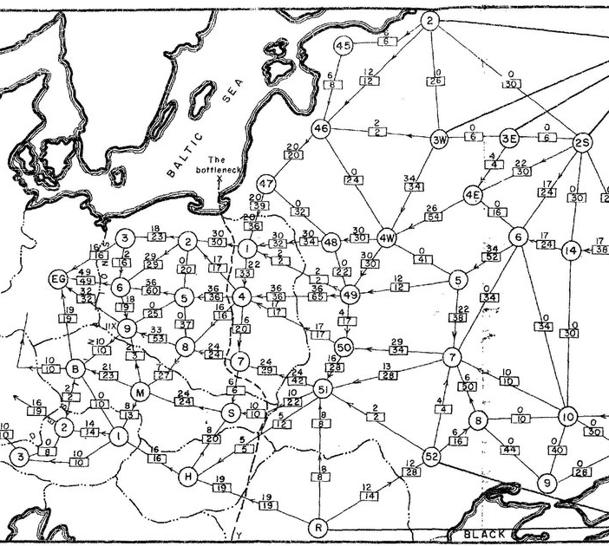
Western Soviet Railway network

Slide 4
Max Flow: Use cases, Application
Liquid flow through pipes: water, oil
Electrical current
Internet packets
Traffic on the street
A bit subtle real-world application: (See wiki for details)
Baseball elimination
Airline scheduling
Image segmentation (finding background and foreground)

Slide 5
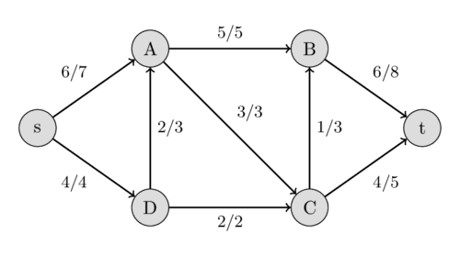
Max Flow: Definitions, Notations
Flow network:
Directed graph (Di-Graph, a network, G (V, E) ) with
a source (s) : outgoing flow only
a sink (t) : incoming flow only
Each edge has a non-negative capacity (c) : the maximum flow, given local constraints of the edge, pipe size
Receives a flow (f) – quantity coming out from ‘t’ (sink)
Flow/Capacity

Slide 6
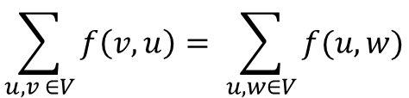

Max Flow: Constraints
For every vertex v, there is a path from the source to the sink
Resources are continuously available at the source and continuously consumed at the sink
Capacity Constraint: The flow of an edge cannot exceed its capacity ,
Conservation of Flows: The sum of the flows entering a node must equal the sum of the flows exiting that node, except for the source and the sink,
Means no accumulation(leaking) in any node
$$0 ≤f\left(u,v\right)≤c\left(u,v\right) for any edge (u,v)$$
$$\sum_{u,v ∈V}{f\left(v,u\right)= \sum_{u,w∈V}{f(u, w)}}$$
Where $u,v,w∈V − \{s,t\}$

Slide 7
Max Flow: Constraints: Example
Flow/Capacity
For every vertex v, there is a path from the source to the sink
Resources are continuously available at the source and continuously consumed at the sink
Capacity Constraint
Conservation of Flows for every vertex v,
(6 + 2) ➔ A ➔ (5 + 3)
(2 + 3) ➔ C ➔ (1 + 4)

Slide 8
Max Flow: A Simple Greedy Approach
A
5
10
t
s
20
B
10
5
Approach:
Choose the path with the largest capacity when scanned
Determine the flow of the path (the lowest capacity)
Update the capacity of each edge in the path
Repeat the steps 1 – 3 until blocked
s -> A -> B -> t : f (10 : S -> A, B-> t)
Greedy flow: 10, not the optimal max flow
No more on S→A (full capacity)
No S → B → t (B → t: full capacity)
Is this a true max flow for the network?
Can we do better?

Slide 9
New approach
A
5
10
t
s
20
How to improve from the first example?
1 Step backward → 2 steps forward
You share the flow (10) between vertices A and B in the network flow
by first cancelling some (5) of the existing flow (A→B) and redirecting to the new alternative path(A→t) but with the same value (5)
the remaining flow value (5) from A→B of the existing path will flow to the existing flow (B→t). Its flow is reduced to (5)
The initial flow (A→B, 10) is split to the sub-paths (A→t and A→B) of the same total flow value. So far, no changes in total flow.
Then find a new additional path S → B →T thanks to the reduced flow from A→B (Total flow: 15)
5
B
10
A
5/5
10/10
10/20
t
s
5/20
10/10
10/10
5/5
B
5/10

Slide 10
Finding Max Flow: Simple Greedy Approach (1/3)
5/5 : 0
5
5/7 : 2
7
5/8 : 3
8
4
5
2
s → A → B → t : f (5 : A → B)
Approach:
Choose the path with the largest capability when scanned
Determine the flow of the path (the lowest capacity)
Update the capacity of each edge in the path
Repeat the steps 1 – 3 until blocked

Slide 11
Max Flow: A Simple Greedy Approach (2/3)
5/5 : 0
5/7 : 2
5/8 : 3
3/3 : 0
3/3 : 0
3/4 : 1
3/5 : 2
Approach:
Choose the path with the largest capacity when scanned
Determine the flow of the path (the lowest capacity)
Update the capacity of each edge in the path
Repeat the steps 1 – 3 until blocked
s → A → B → t : f (5 : A → B)
s → D → A → C -> t : f (3, D → A)

Slide 12
Max Flow: A Simple Greedy Approach (3/3)
5/5 : 0
5/7 : 2
5/8 : 3
3/3 : 0
3/3 : 0
3/4 : 1
3/5 : 2
4/4 : 0
4/5 : 1
1/2 : 1
Approach:
Choose the path with the largest capacity when scanned
Determine the flow of the path (the lowest capacity)
Update the capacity of each edge in the path
Repeat the steps 1 – 3 until blocked
s → A → B → t : f (5 : A → B)
s → D → A → C -> t : f (3, D → A)
s → D → C → t : f (1 : s -> D)
No more path to add more flow !!
Total flow: 5 + 3 + 1 = 9, close but not the optimal solution
Can we do better?

Slide 13
How to increase flow? Reversal: 1 step backward, 2 steps forward
5/5
5/7
5/8
3/3
3/3
4/4
3/5 : 2
4/5
Max Flow Approach
Simple Greedy Approach
1/2
5/7
Reduce 3 to 2 (D→A)
Increase 1 to 2 (D→C)
(3 + 1 = 2 + 2)
Increase 5 to 6 (s→A)
(5 + 3 = 6 + 2)
Total: Increase 9 to 10
5/5 : increased by 1
1/2
Back to Slide 22

Slide 14
Finding Maxflow
Ford-Fulkerson Algorithm
(Incremental Improvement)

Slide 15
Incremental improvement
# Find the maximal sum of the list below
# solution: Add them all, one by one
# Does the order of additions matter as long as all of them are added up?
intList = [21, 5, 34, 54, 44]
sum = 0
for anElement in intList :
sum += anElement
print(“Total: “, sum)

Slide 16
Ford-Fulkerson Algorithm
An optimization solution by taking an incremental improvement approach:
Find a directed path (p: s to t) (an initial assignment)
Find the minimum capacity on the path p: f
Assign the flow value of the network to the minimum capacity on the path (the weakest link)
Build a “residual graph”, G_{f} for a given f
Find an “augmented path” which add more flow from G_{f}
Repeat the process from step 2.
*** See CLRS pp 726 – 727

Slide 17
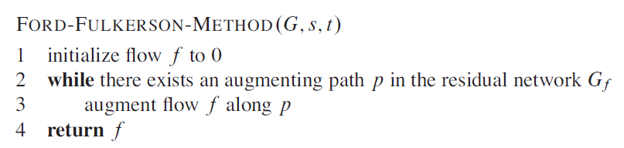
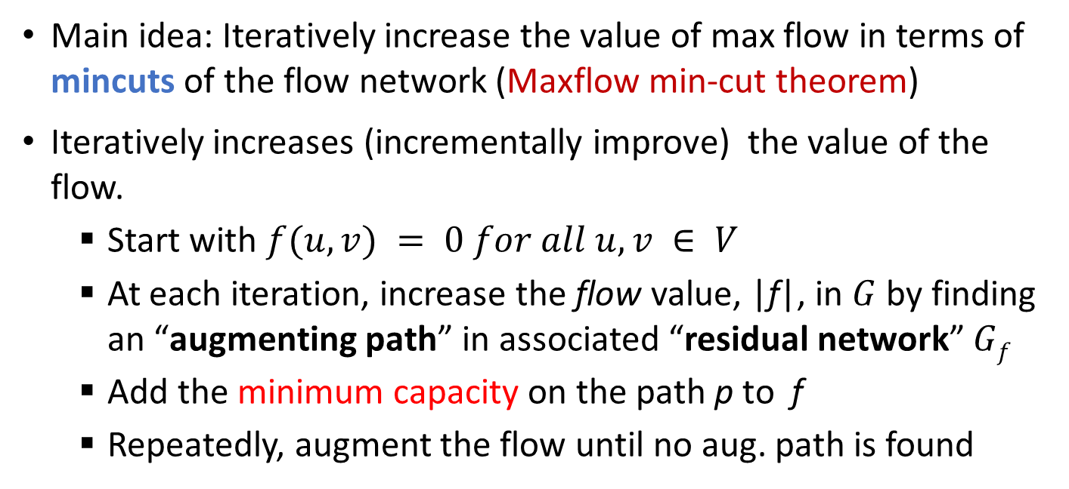
Ford-Fulkerson Method
Main idea: Iteratively increase the value of max flow in terms of mincuts of the flow network (Maxflow min-cut theorem)
Iteratively increases (incrementally improve) the value of the flow.
Start with $f(u, v) = 0 for all u, v ∈ V$
At each iteration, increase the flow value, |f|, in $G$ by finding an “augmenting path” in associated “residual network” $Gf$
Add the minimum capacity on the path p to f
Repeatedly, augment the flow until no aug. path is found
See CLRS
pp 726 – 727

Slide 18

Three Important Concepts
Residual Networks (Graph. $Gf$)
Augmenting Paths ($P$)
Cuts of Flow Networks: Min cut (min capacity)

Slide 19
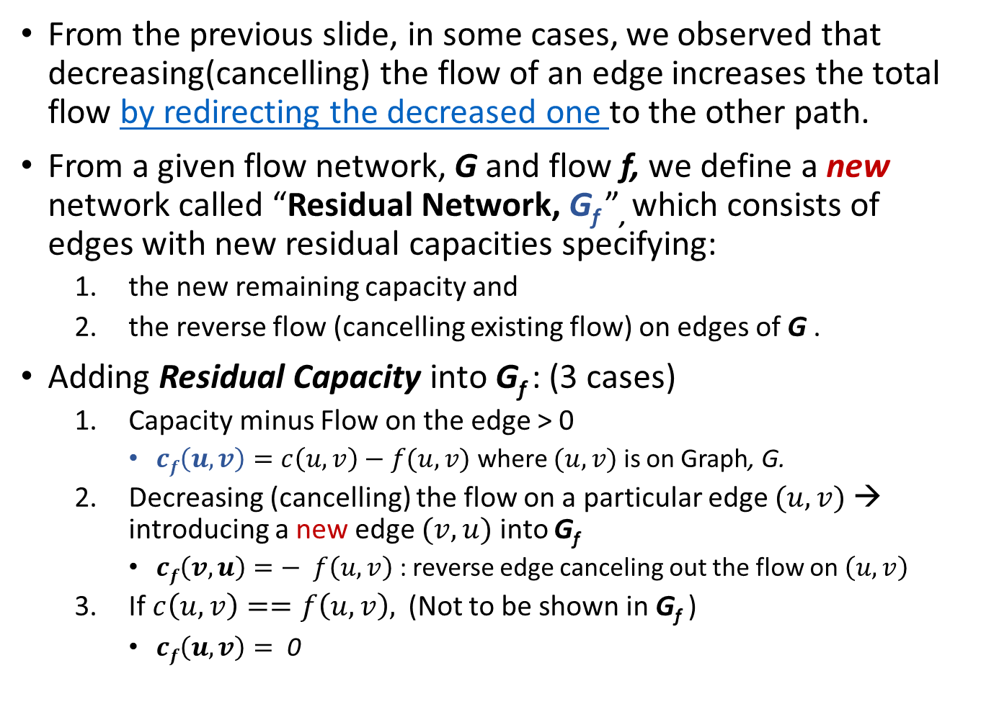
Residual Networks, G_{f}
From the previous slide, in some cases, we observed that decreasing(cancelling) the flow of an edge increases the total flow by redirecting the decreased one to the other path.
From a given flow network, G and flow f, we define a new network called “Residual Network, G_{f} ”, which consists of edges with new residual capacities specifying:
the new remaining capacity and
the reverse flow (cancelling existing flow) on edges of G .
Adding Residual Capacity into G_{f} : (3 cases)
Capacity minus Flow on the edge > 0
$cf\left(u,v\right)=c\left(u,v\right)−f(u,v)$ where $(u,v)$ is on Graph, G.
Decreasing (cancelling) the flow on a particular edge $(u,v)$ → introducing a new edge $(v, u)$ into G_{f}
$cf\left(v, u\right)=− f\left(u,v\right)$ : reverse edge canceling out the flow on $\left(u,v\right)$
If$c\left(u,v\right)==f\left(u,v\right),$(Not to be shown in G_{f} )
$cf\left(u,v\right)= \text{0}$

Slide 20
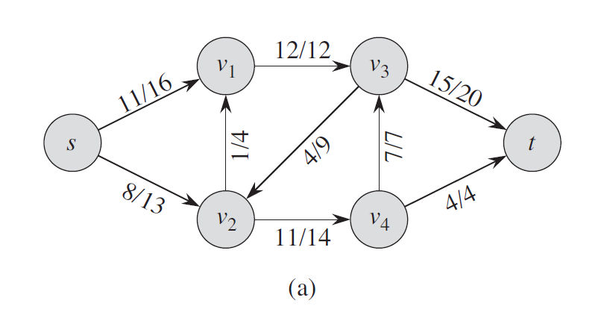
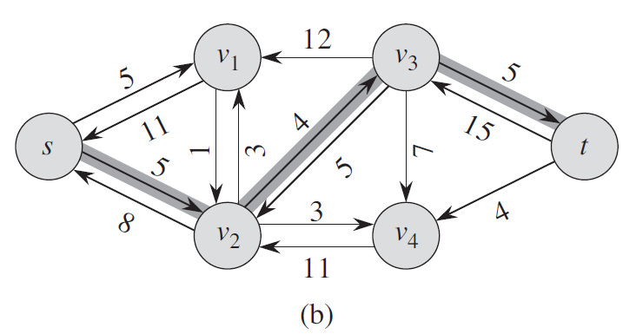
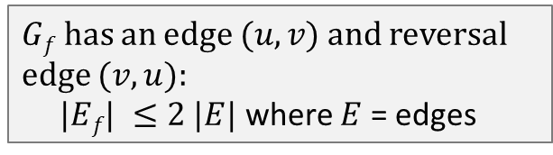


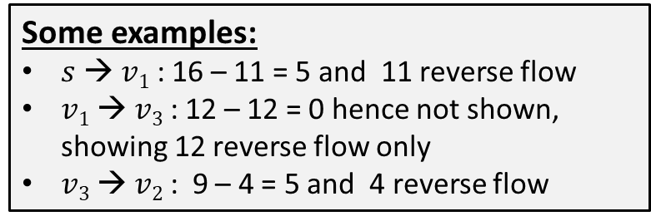
Residual Network Example (CLRS 717)
$$G$$
Some examples:
$s$ → $v1$ : 16 – 11 = 5 and 11 reverse flow
$v1$ → $v3$ : 12 – 12 = 0 hence not shown, showing 12 reverse flow only
$v3$ → $v2$ : 9 – 4 = 5 and 4 reverse flow
$$Gf$$
$Gf has$an edge $(u,v)$ and reversal edge $(v, u):$
$|Ef| ≤2 |E|$where $E$ = edges

Slide 21
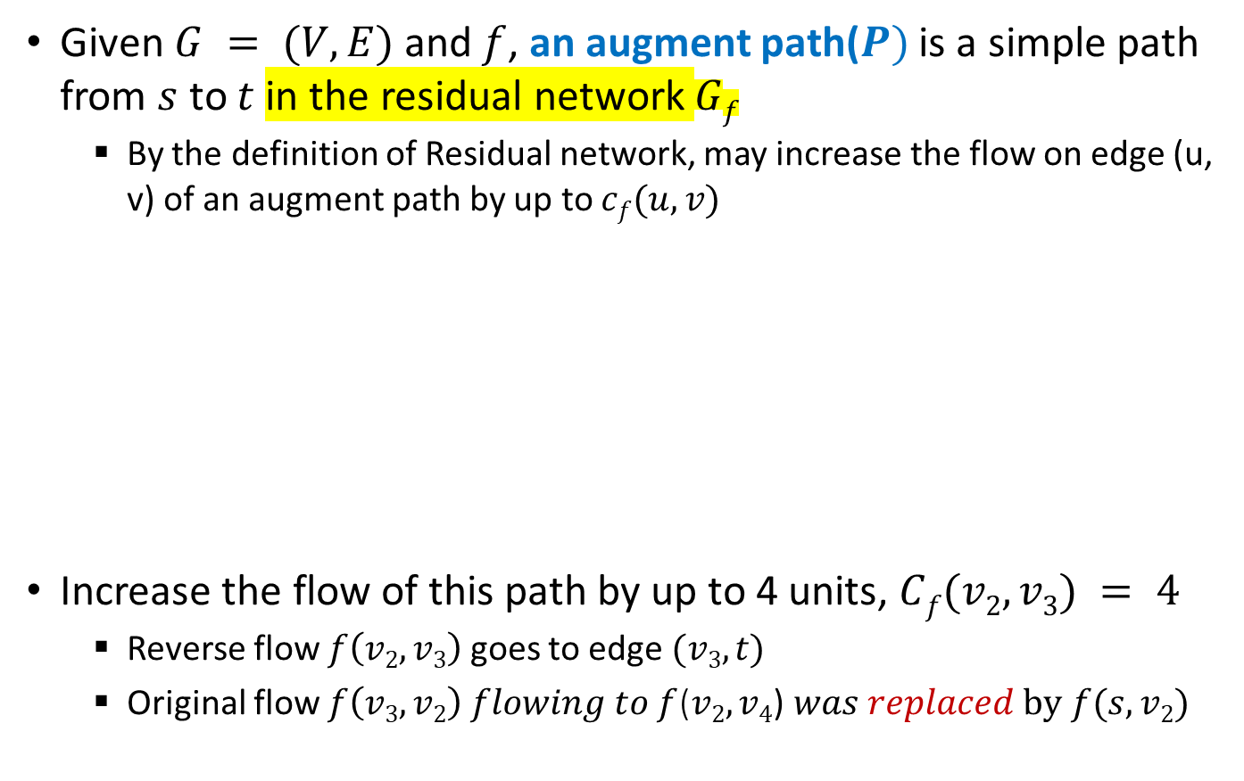
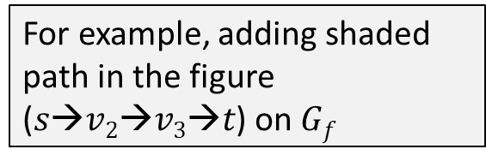
Augmenting Path
Given $G = (V, E)$and $f$, an augment path($P)$ is a simple path from $s$ to $t$ in the residual network $Gf$
By the definition of Residual network, may increase the flow on edge (u, v) of an augment path by up to $cf(u, v)$
Increase the flow of this path by up to 4 units, $Cf(v2, v3) = 4$
Reverse flow $f\left(v2, v3\right)$ goes to edge $(v3, t)$
Original flow $f\left(v3, v2\right) flowing to f$($v2, v4$)$was replaced by f(s, v2)$
For example, adding shaded path in the figure ($s→v2→v3→t$) on $Gf$

Slide 22
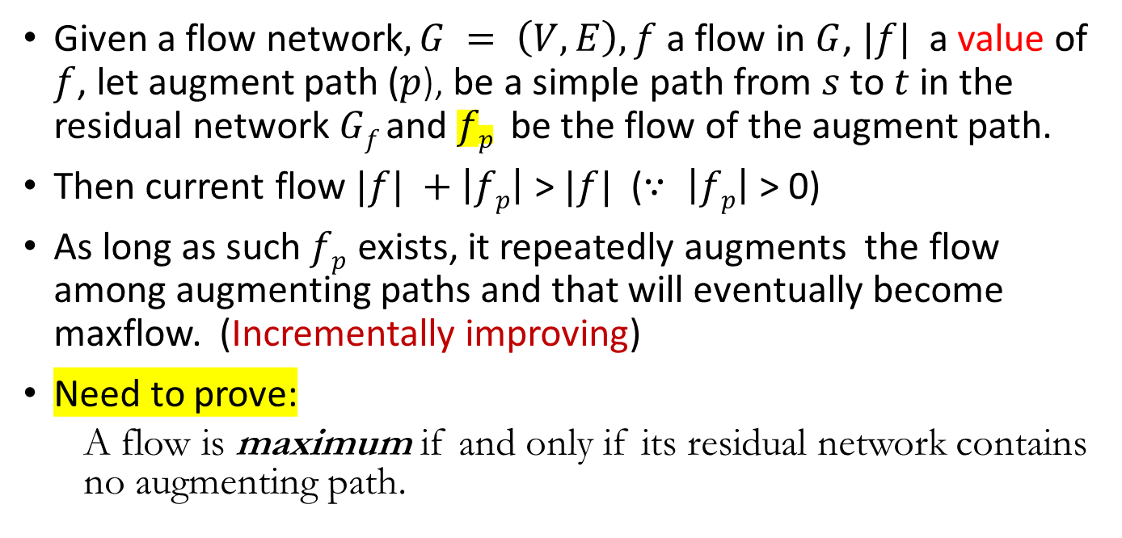
Incremental Improving to maxflow
Given a flow network$, G = \left(V, E\right),$ $f$ a flow in $G$, $|f|$ a value of $f$, let augment path ($p$), be a simple path from $s$ to $t$ in the residual network $Gf$ and $fp$ be the flow of the augment path.
Then current flow $|f| +\left|fp\right|$ > $|f|$ ($∵ \left|fp\right|$ > 0)
As long as such $fp$ exists, it repeatedly augments the flow among augmenting paths and that will eventually become maxflow. (Incrementally improving)
Need to prove:
A flow is maximum if and only if its residual network contains no augmenting path.

Slide 23
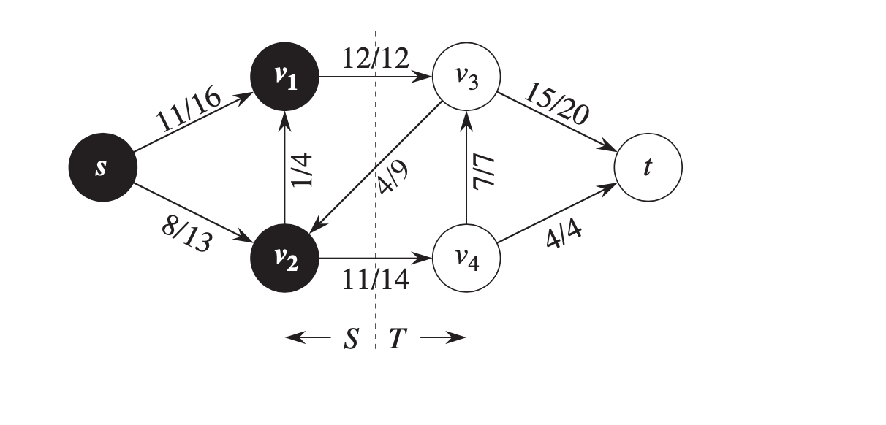

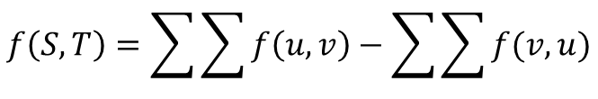

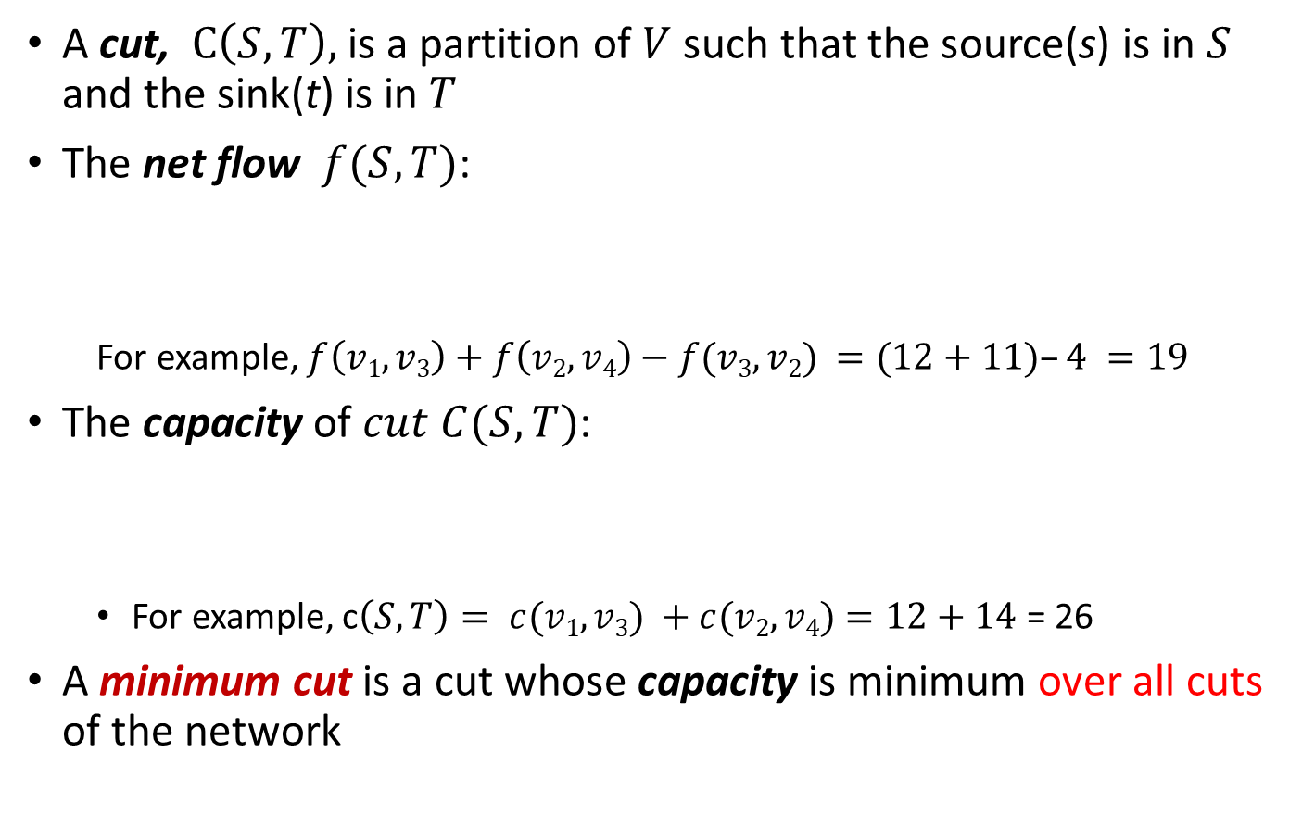



Cuts of flow networks: Definitions
A cut, $C\left(S,T\right),$ is a partition of $V$ such that the source(s) is in $S$ and the sink(t) is in $T$
The net flow $f(S,T)$:
For example, $f\left(v1, v3\right)+f\left(v2, v4\right)−f(v3, v2) =(12+11)–4 =19$
The capacity of $cut C(S,T)$:
For example, c$\left(S,T\right)= c(v1,v3) +c(v2, v4)=12+14$ = 26
A minimum cut is a cut whose capacity is minimum over all cuts of the network
$$f\left(S,T\right)=\sum{\sum{f\left(u,v\right)−\sum{\sum{f(v,u)}}}}$$
$$u∈S$$
v$∈T$
$$u∈S$$
v$∈T$
c$\left(S,T\right)=\sum{\sum{c\left(u,v\right)}}$
$$u∈S$$
v$∈T$

Slide 24
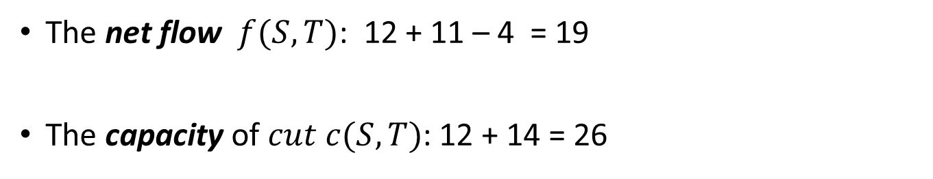
Cuts of flow networks: Example
CLRS Page 721
The net flow $f(S,T)$: 12 + 11 – 4 = 19
The capacity of $cut c(S,T)$: 12 + 14 = 26

Slide 25
Proof & Time Efficiency

Slide 26
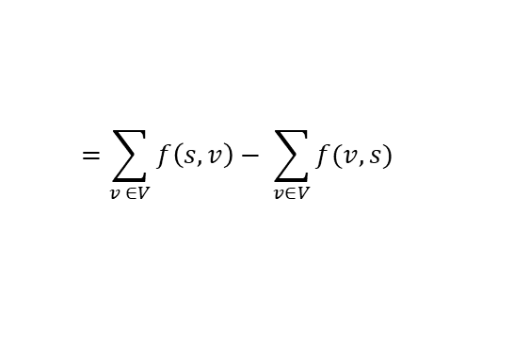



Cuts of flow networks: Lemma
CLRS Page 720 -721
Lemma : For any $cut (S,T)$ of $G$, $netflow of cut \left(S,T\right),$ $f(S,T) = |f|$
$$f\left(S,T\right)=\sum{\sum{f\left(u,v\right)−\sum{\sum{f(v,u)}}}}$$
$$u∈S$$
v$∈T$
$$u∈S$$
v$∈T$
$$=\sum_{v ∈V}{f\left(s,v\right)− \sum_{v∈V}{f(v,s)}}$$
$$=\left| f\right| , the value of a flow fof G$$
(= 19 for the example )

Slide 27
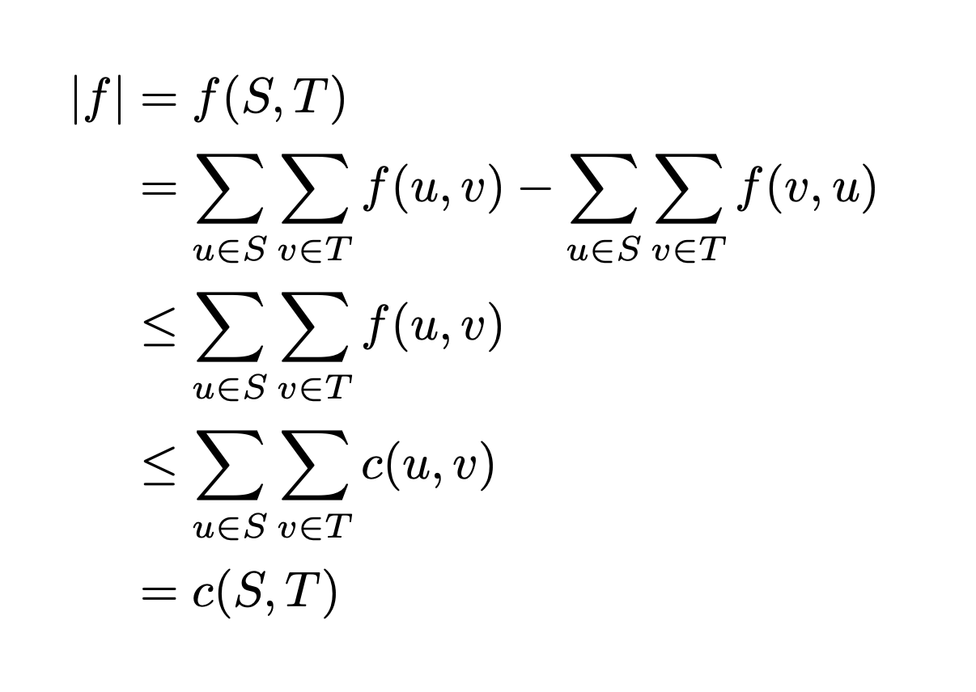
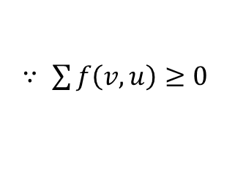
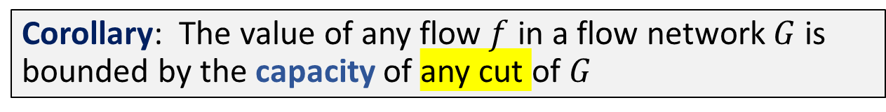

Cuts of flow networks: Corollary
Corollary: The value of any flow $f$ in a flow network $G$ is bounded by the capacity of any cut of $G$
$∵ \sum{f\left(v, u\right)≥0}$
$∵c\left(u,v\right)≥f\left(u,v\right)$, capacity constraint
The value of the maximum flow is bound by the capacity of a minimum cut of the network (upper limit).

Slide 28
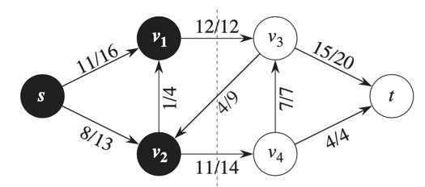
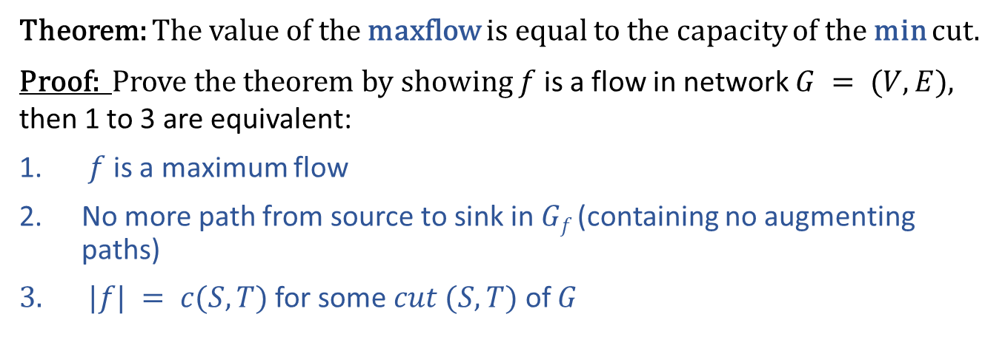
Max-Flow Min-Cut Theorem
Theorem: The value of the maxflow is equal to the capacity of the min cut.
Proof: Prove the theorem by showing $f$ is a flow in network $G = (V,E),$ then 1 to 3 are equivalent:
$f$ is a maximum flow
No more path from source to sink in $Gf$ (containing no augmenting paths)
$|f| = c(S,T)$for some $cut (S,T)$ of $G$
Maxflow: 23 (12+7+4)

Slide 29

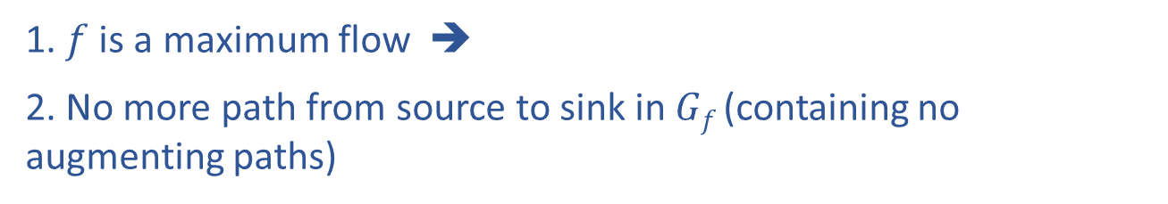
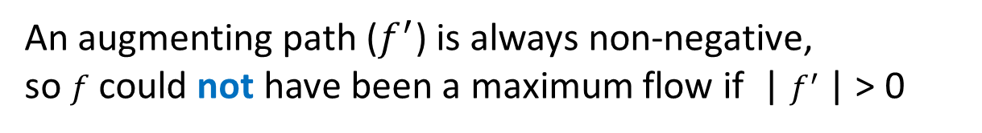

Max-Flow Min-Cut Theorem Proof
1. $f$ is a maximum flow ➔
2. No more path from source to sink in $Gf$ (containing no augmenting paths)
Assume an augmenting path, $f^{′}$, exists:
|$f+f^{′}| =\left|f\right|+|f^{′}|$
An augmenting path ($f^{′}$) is always non-negative,
so $f$ could not have been a maximum flow if | $f^{′}$| > 0

Slide 30
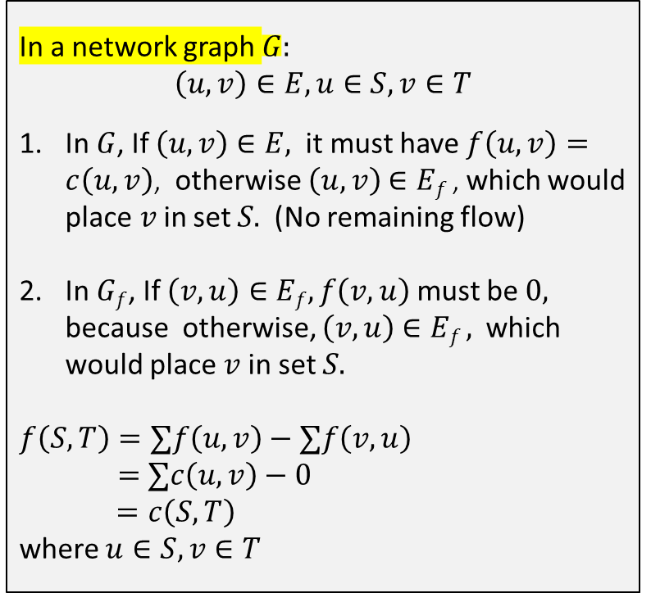
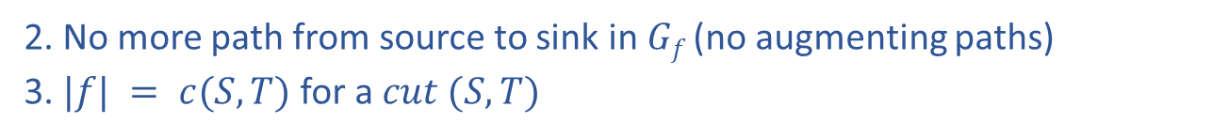


Min-Cut Theorem Proof
2. No more path from source to sink in $Gf$ (no augmenting paths)
3. $|f| = c(S,T)$for a $cut (S,T)$
In a network graph $G:$
$$\left(u, v\right)∈E, u∈S, v∈T$$
In $G$, If $\left(u,v\right)∈E,$it must have $f\left(u,v\right)=c\left(u,v\right)$, otherwise $\left(u,v\right)$ $∈Ef$, which would place$v$in set $S.$ (No remaining flow)
In $Gf$, If $\left(v,u\right)∈Ef, f\left(v,u\right)$must be$0,$ because otherwise, $\left(v,u\right)$ $∈Ef ,$which would place $v$in set $S.$
$$f\left(S,T\right)=∑f\left(u,v\right)−∑f\left(v,u\right)$$
$=$ $∑c\left(u,v\right)−0$
$=c\left(S,T\right)$
where $u∈S, v∈T$
In a residual graph($Gf$), there exists no augmenting path.
➔
It makes a cut where
$$S=u∈V:∃ a path from s to u$$
$$T=V−S$$
S
T
s
t
u
v
$$Gf$$

Slide 31
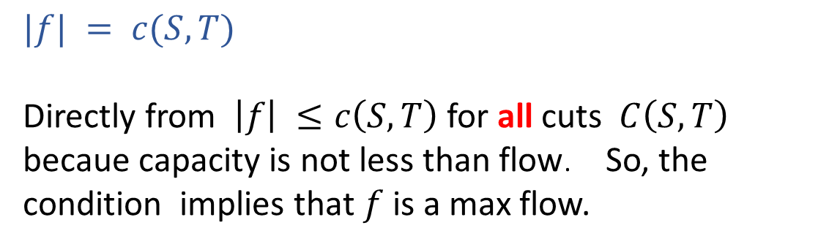
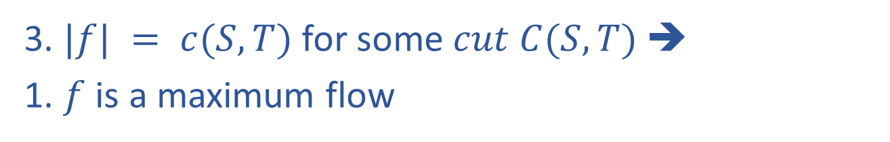
Min-Cut Theorem Proof
3. $|f| = c(S,T)$for some $cut C(S,T)$ ➔
1. $f$ is a maximum flow
$$|f| = c(S,T)$$
Directly from $\left|f\right| ≤c\left(S,T\right)$for all cuts $C\left(S,T\right)$ becaue capacity is not less than flow. So, the condition implies that $f$ is a max flow.
We are done!

Slide 32
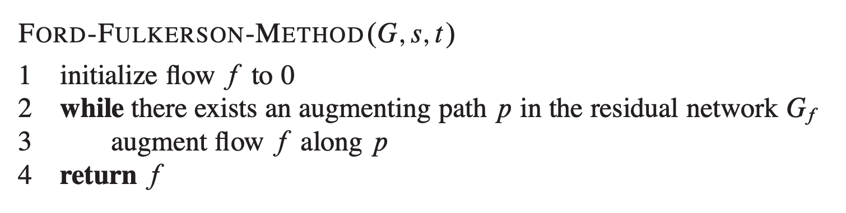
Max-Flow Min-Cut Theorem implies that Ford-Fulkerson returns max flow
Why? We just proved it:
No augment path → Maxflow
*** In the for-loop analogy, the loop traversal hits the end of list → no more element to add
!!! Ford-Fulkerson algorithm example: CLRS pp 726 - 727

Slide 33
Running time of Ford-Fulkerson
O(E)
O(|f*|) where |f*|=maximum flow
worst case: flow increase by one at each iteration
(assuming integer values)
O(E |f*|), where |f*|: the maximum flow

Slide 34
O(E |f*|) example
Searching for next augmenting Path:
Depth-First Search
a
1000
1000
s
t
1
1000
1000
b

Slide 35
O(E |f*|) example
a
a
1000
999
1000
1000
1
s
t
s
t
1
1
1
1000
1000
1000
999
b
b
Flow Network
Residual Network

Slide 36
O(E |f*|) example
a
a
999
1
999
1000
1
999
1
s
t
s
t
1
1
1
1
1
1000
999
999
999
b
b
Flow Network
Residual Network
You could keep increasing it by 1 for a long time…

Slide 37
Running time Ford-Fulkerson?
If you find the shortest path by breadth-first search, O(VE²) known as the Edmonds-Karp algorithm
There are a few more improved versions (CLRS pp 736 – 760)

Slide 38
Maxflow/Mincut Example

Slide 39
Example 1/2
Residual | Network flow
Original:
17
b
17
d
b
d
6/23
6/22
23
22
6/6
6
f
a
13
f
a
18
13
6/18
19
19
c
e
20
c
e
20
7
f: 6
7
17
b
17
d
b
d
16
6/23
6/22
17
6
6
6
6
f
a
6/6
13
f
a
12
13
6/18
19
e
20
7/19
c
e
7/20
c
7
7/7
f: 6+7=13
b
16/17
d
b
17
d
22/23
22/22
17
16
6
6
6
a
6/6
13
f
a
7
6
13
f
6/18
12
13
7/19
12
7
c
e
7/20
c
e
7/7
f: 13+16=29
7

Slide 40
Example 2/2
Residual | Network flow
b
1
d
b
16/17
d
1
16
22
22/23
22/22
a
22
6
6
f
a
6/6
f
7
12
13
13
18/18
12/13
12
c
e
7
19/19
c
e
19/20
7
7/7
f: 29+12=41
1
b
17/17
d
b
d
23/23
22/22
1
16
22
22
18
1
f
a
6/6
13/13
f
a
6
12
1
18/18
19
19/19
c
e
20/20
c
e
19
7/7
7
f: 41+1=42
b
17
d
23
22
a
6
18
13
f
19
c
e
20
7
No more augmenting path !!

